Slide 1

Notes:
Heelo My name is Anisha from CSE Safe Street is an innovative solution designed to enhance road safety by enabling users to report road damages quickly and efficiently through a mobile app. The app allows users to capture images of road issues, automatically attaches location data, and leverages AI-powered image analysis to classify and summarize the damage. The backend system securely manages user authentication, data storage, and integrates with AI models for real-time damage assessment. Supervisors can monitor reports via a web dashboard with map visualizations and detailed report management. This comprehensive approach streamlines road maintenance, prioritizes urgent repairs, and ultimately contributes to safer streets for everyone.

Slide 2

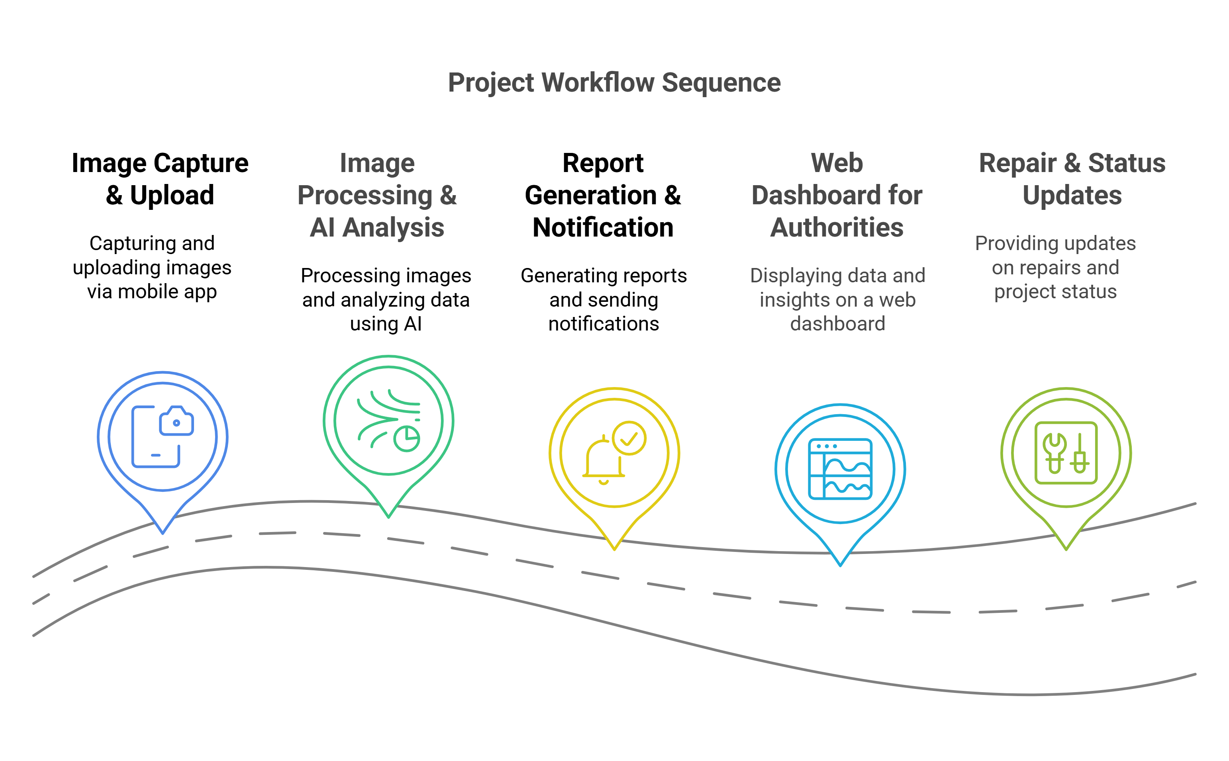
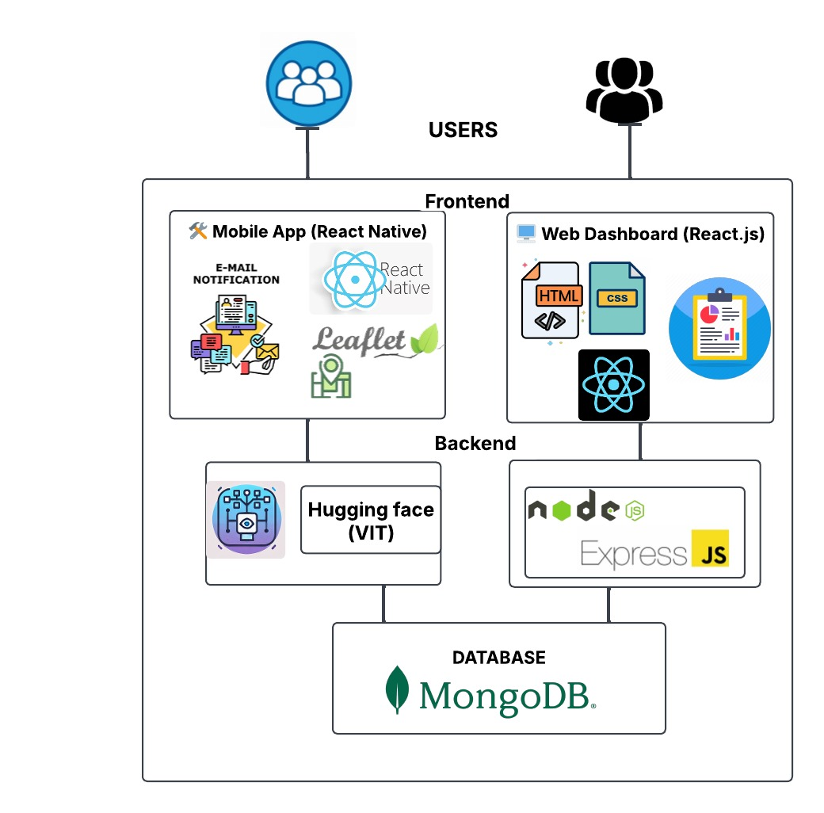
Notes:
This diagram summarizes the Safe Street system workflow, showing image capture via the mobile app, AI-powered image analysis, report generation with notifications, a web dashboard for authorities, and repair status updates. The architecture integrates React Native and React.js frontends, a Node.js backend with Express, AI processing using Hugging Face’s Vision Transformer, and MongoDB for data storage.

Slide 3
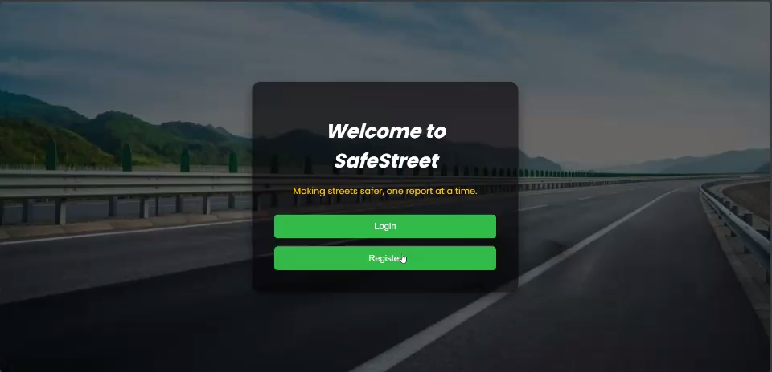

Slide 4

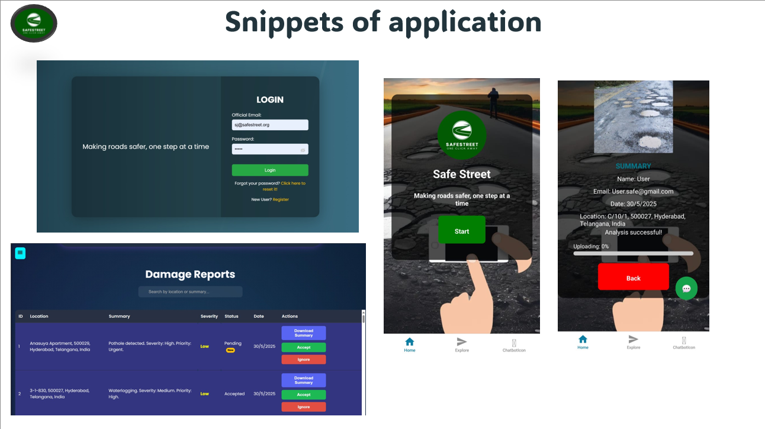
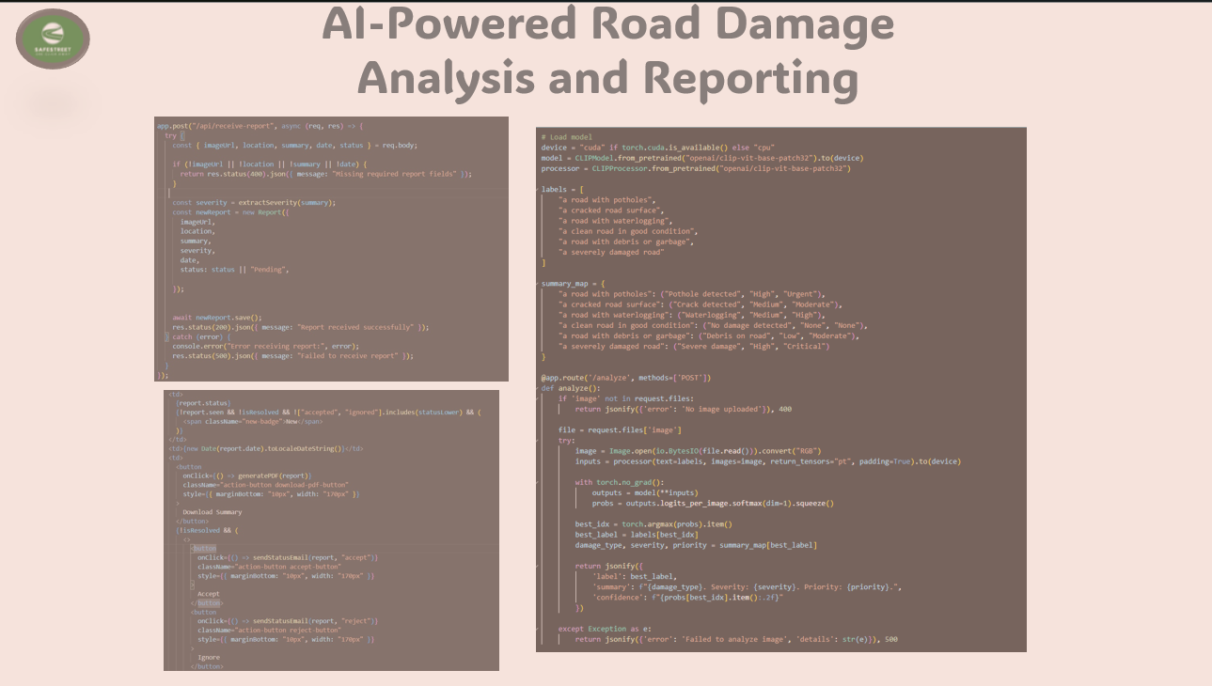
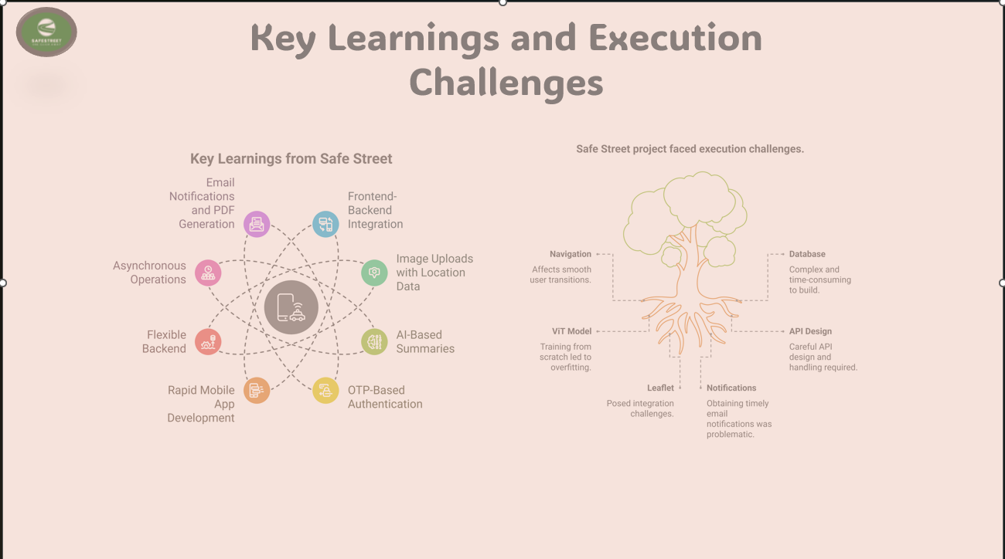

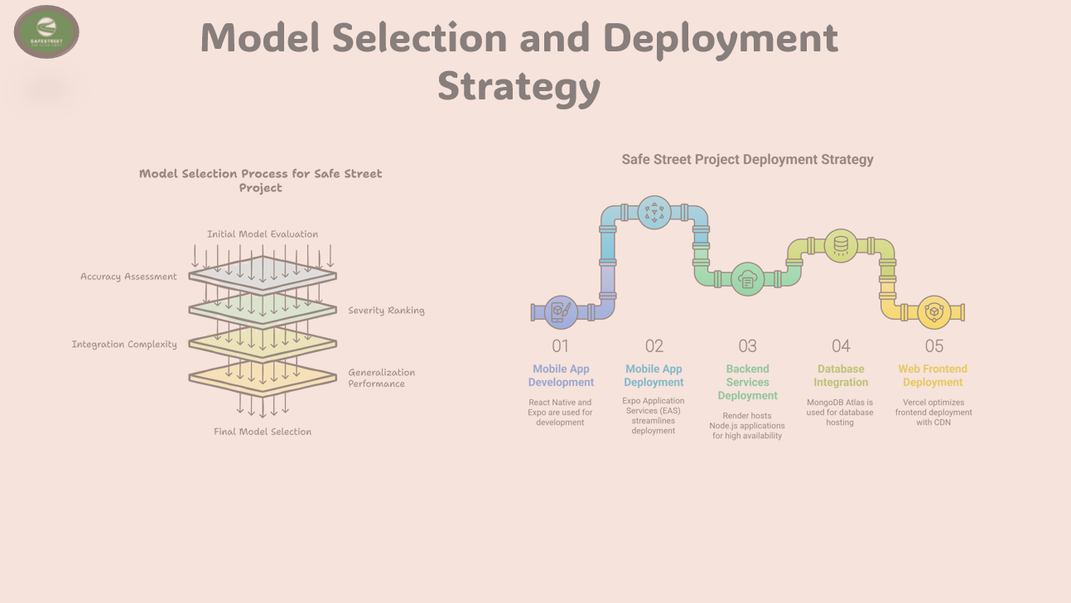

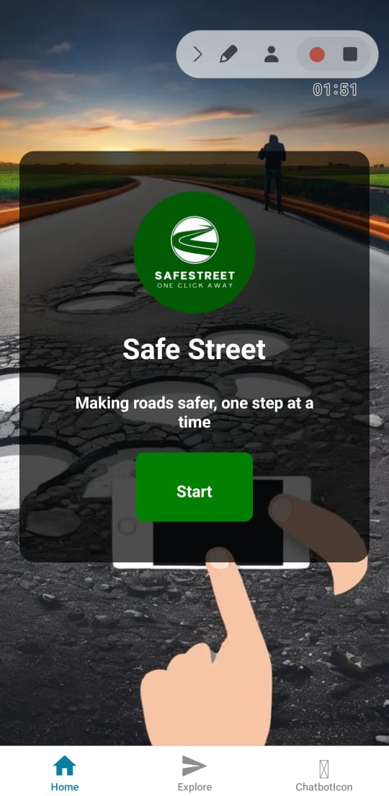
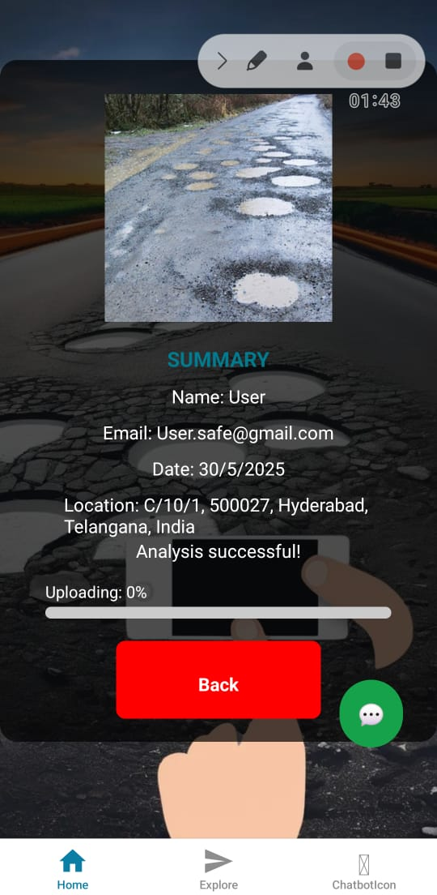
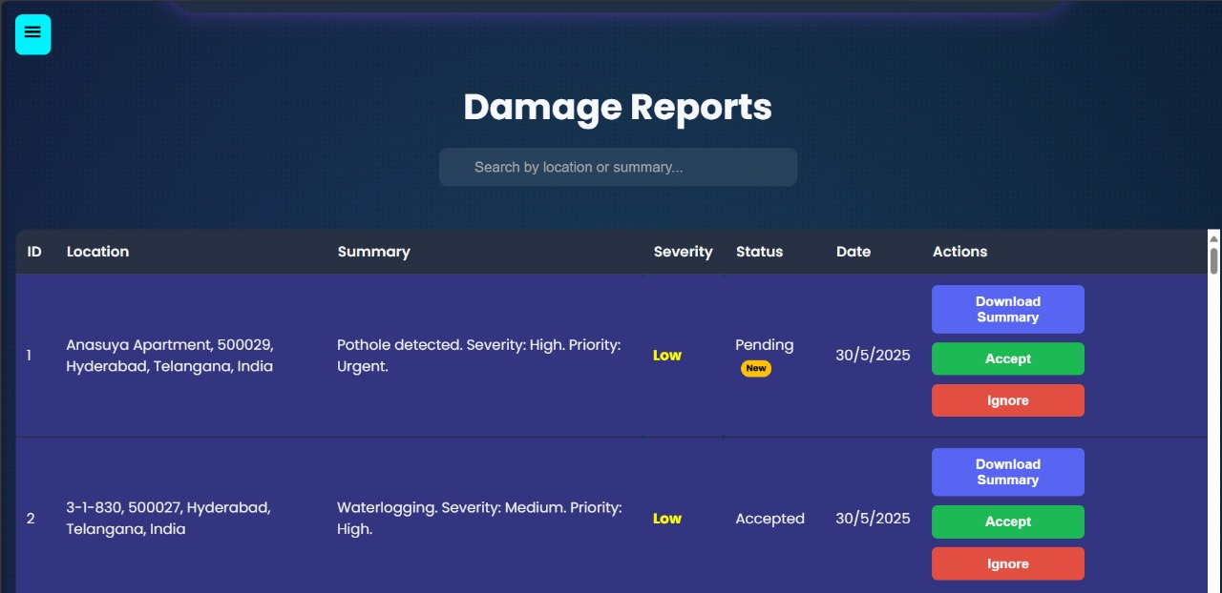
Snippets of application

Slide 5
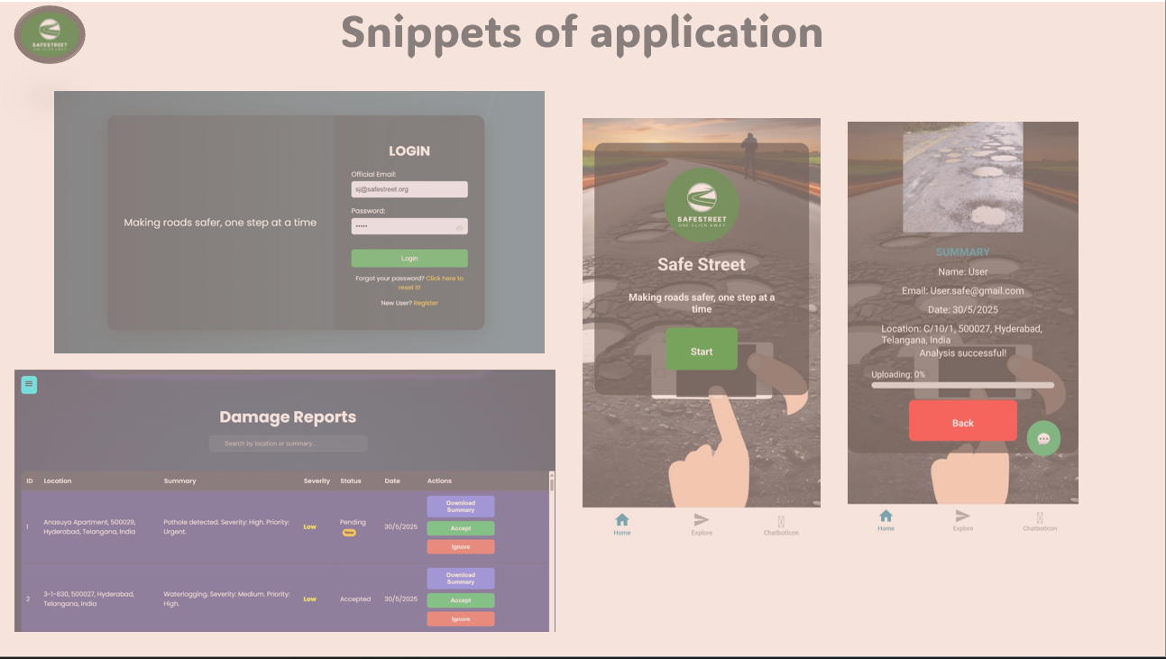
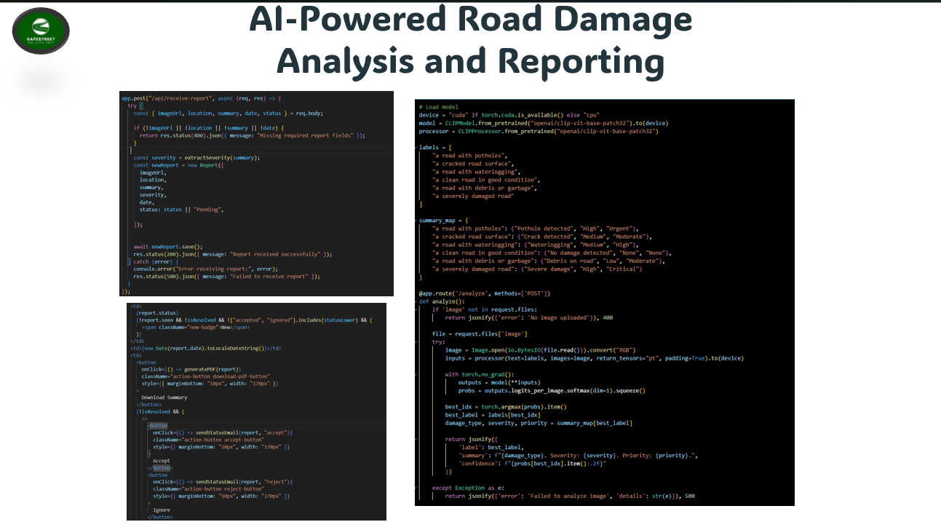
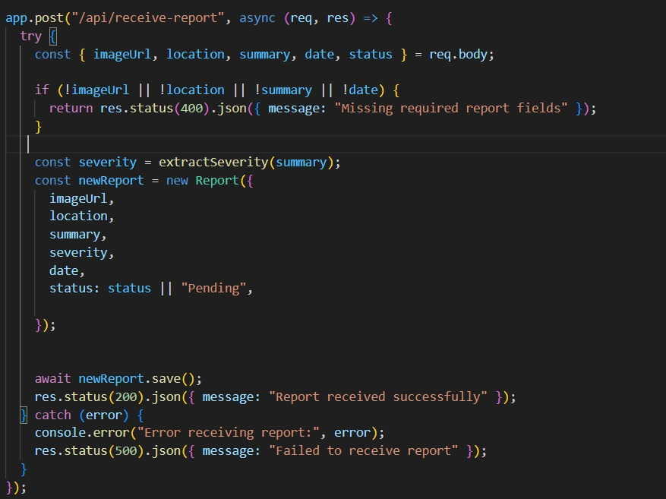
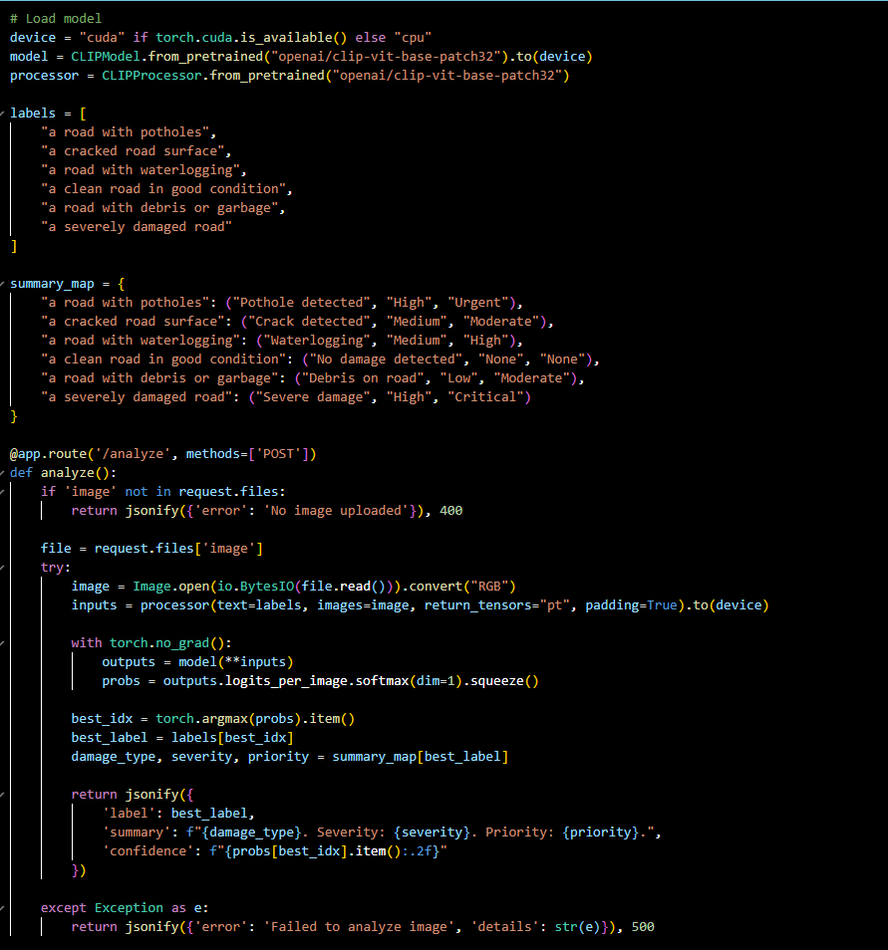
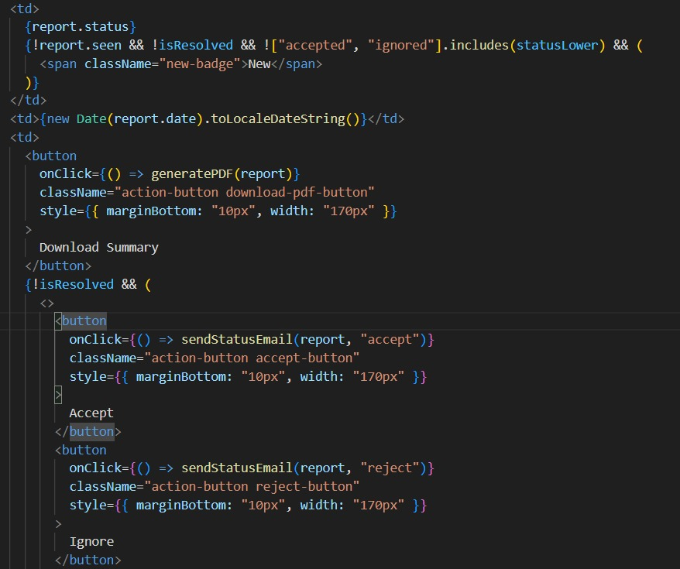
AI-Powered Road Damage Analysis and Reporting

Slide 6
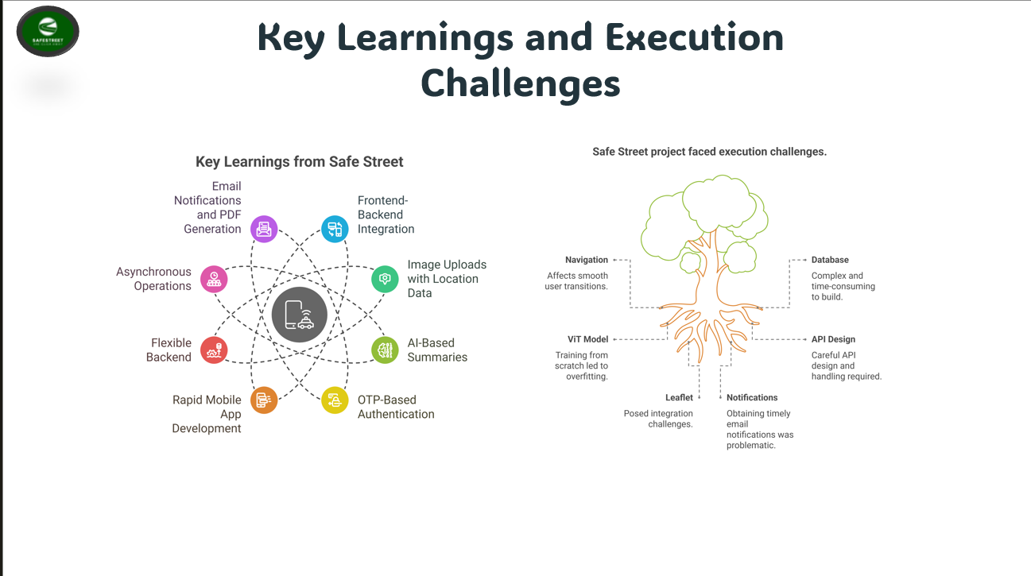
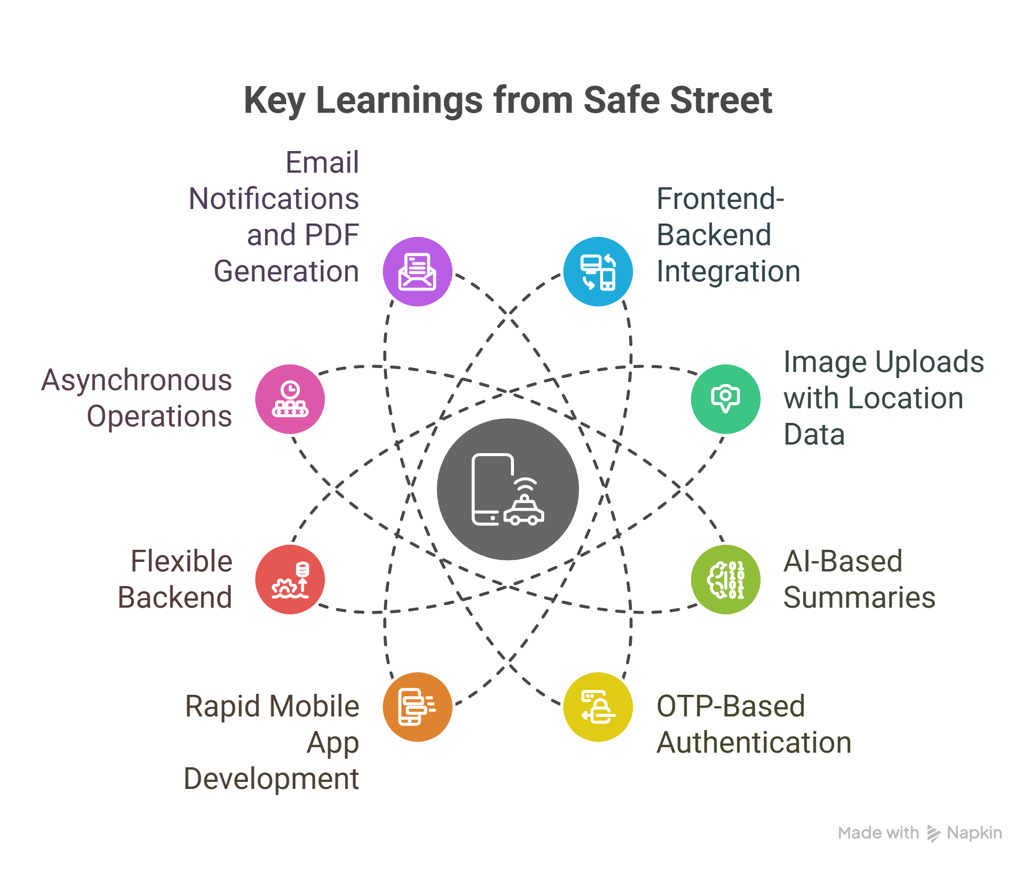
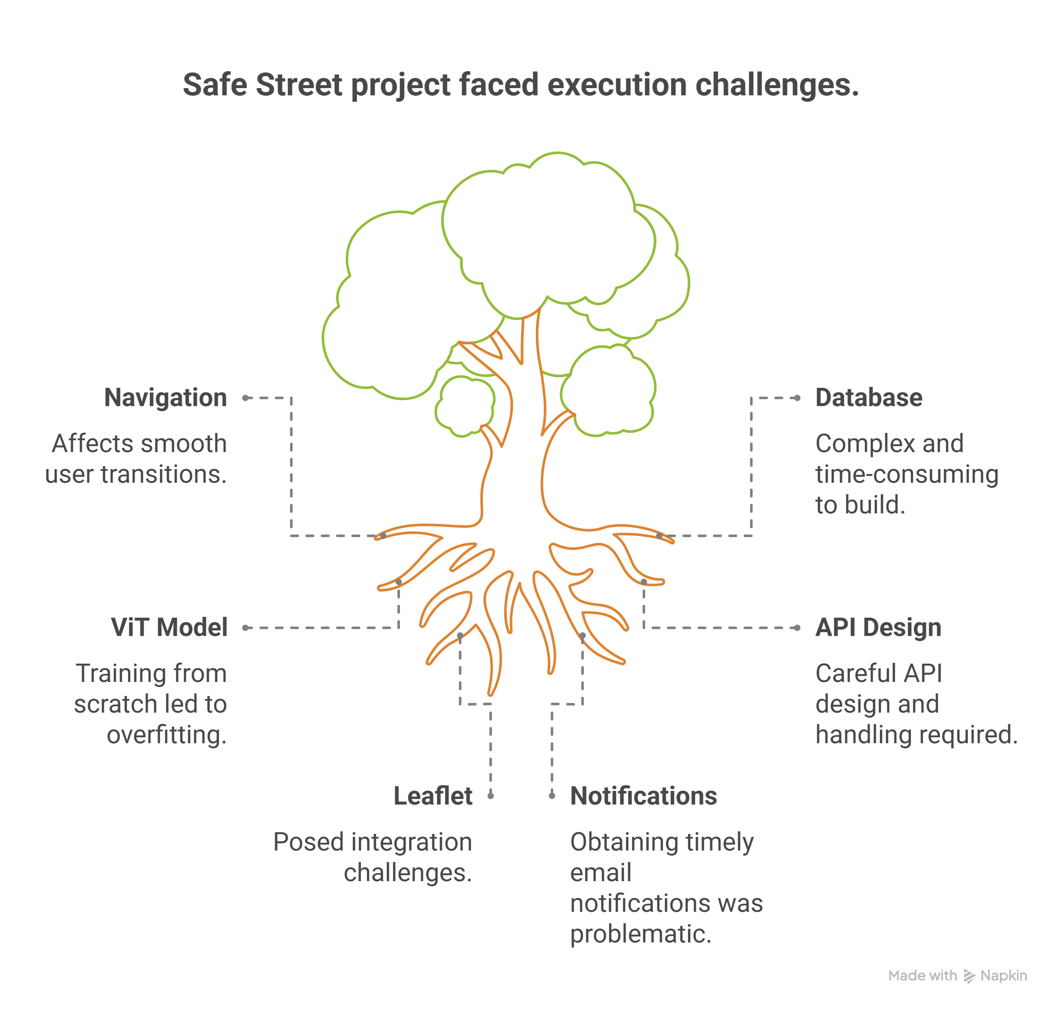
Key Learnings and Execution Challenges
Notes:
In developing Safe Street, we learned the importance of seamless frontend-backend integration, efficient image uploads with accurate location data, and the power of AI-based summaries for precise damage assessment. We implemented OTP-based authentication and asynchronous operations to enhance user experience and system responsiveness. However, we faced challenges such as navigation issues affecting smooth user transitions, the complexity of building the database from scratch, overfitting during Vision Transformer model training, integration hurdles with Leaflet maps, and difficulties in obtaining timely email notifications. These experiences have strengthened our approach and improved the overall solution.

Slide 7

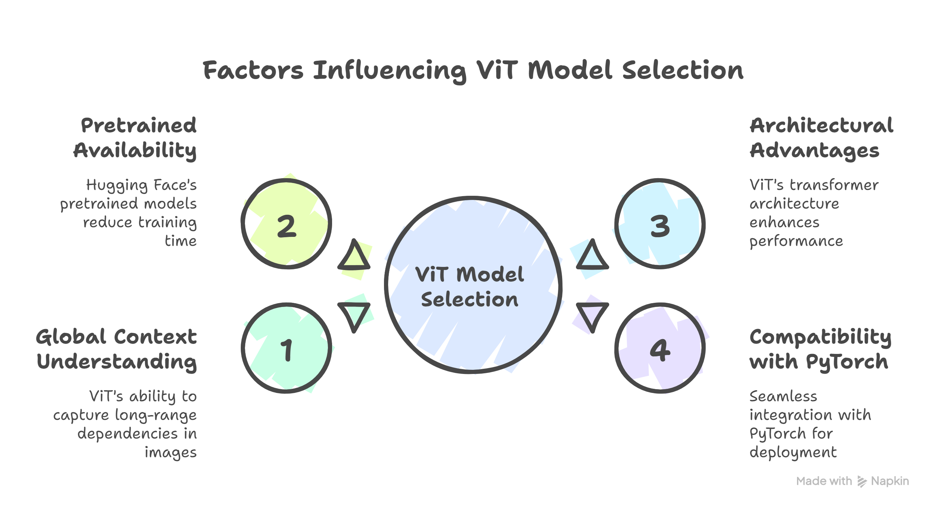
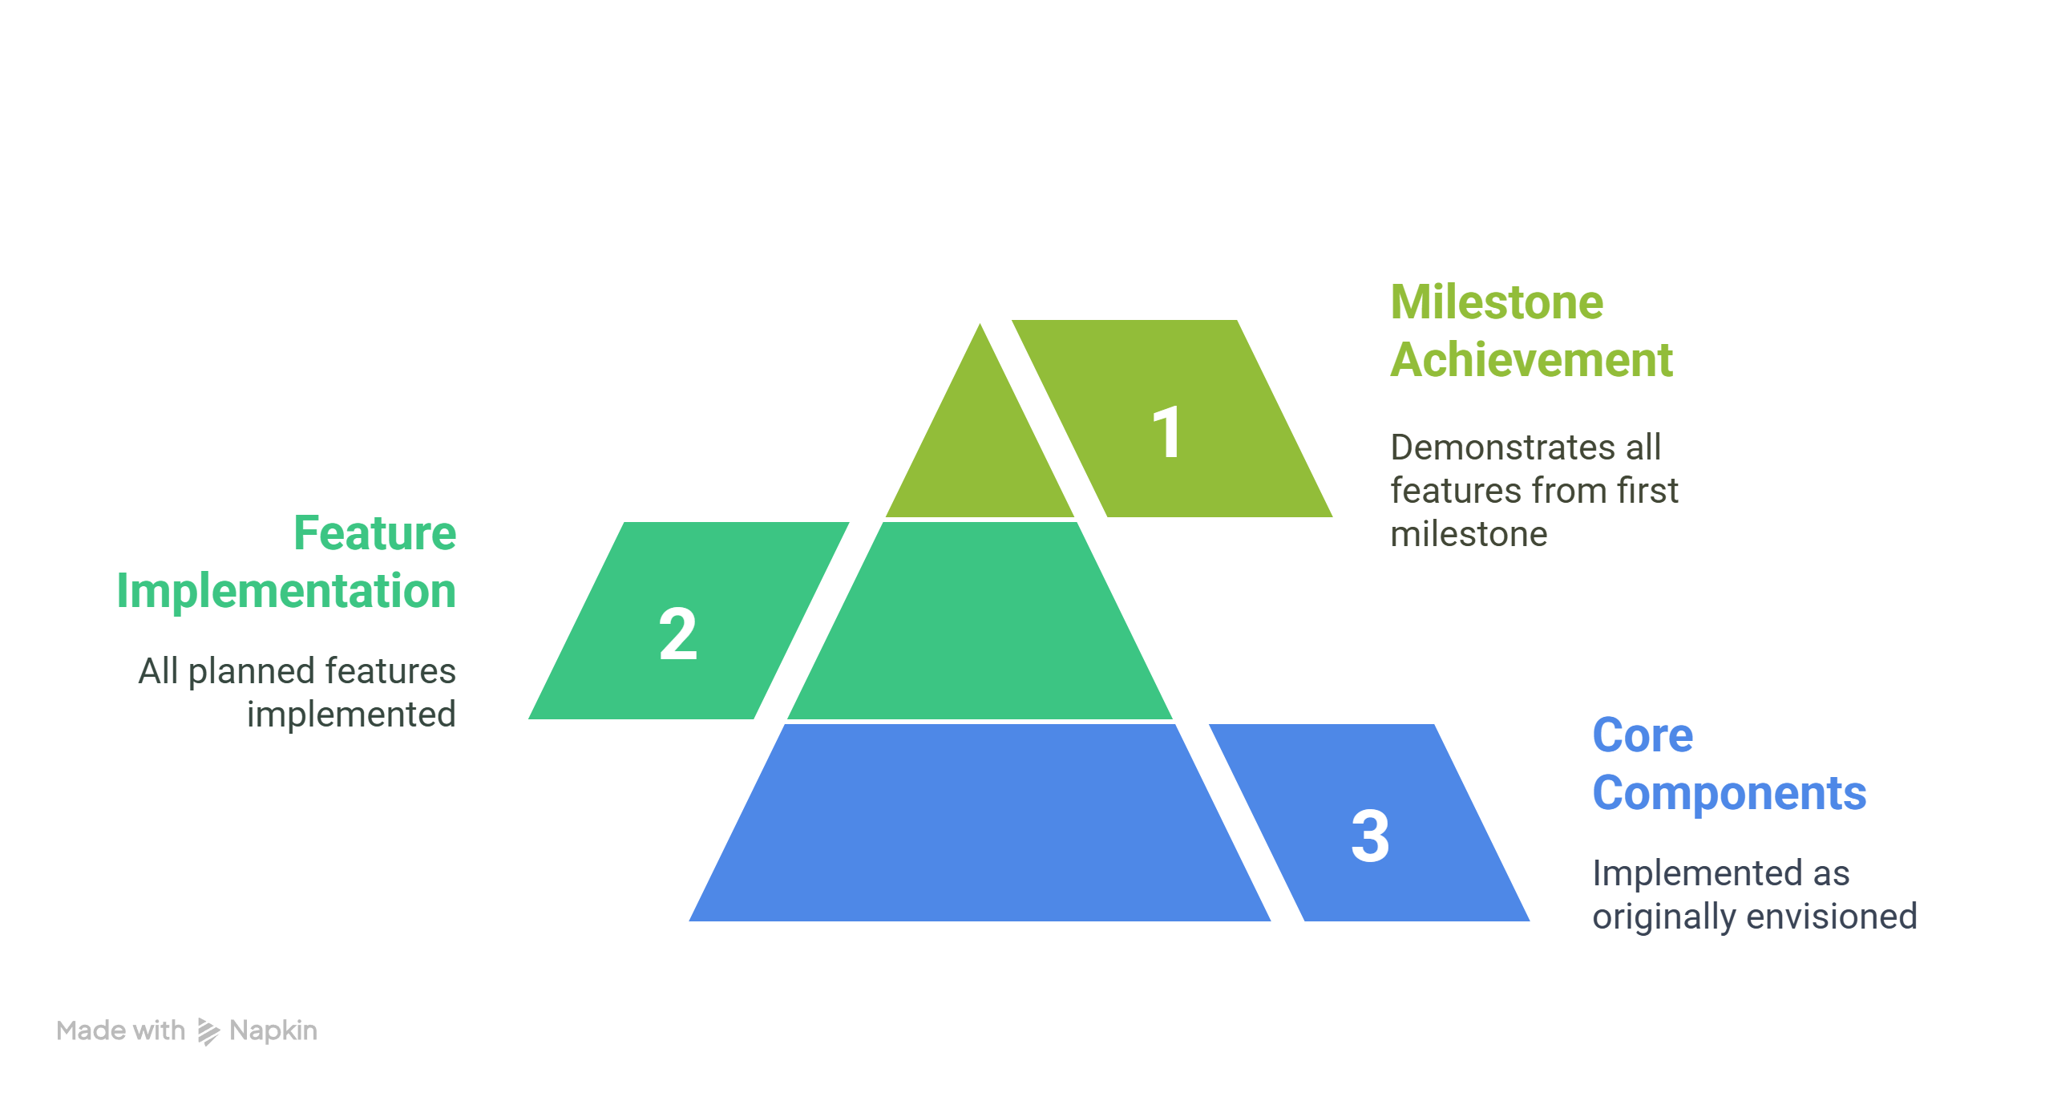
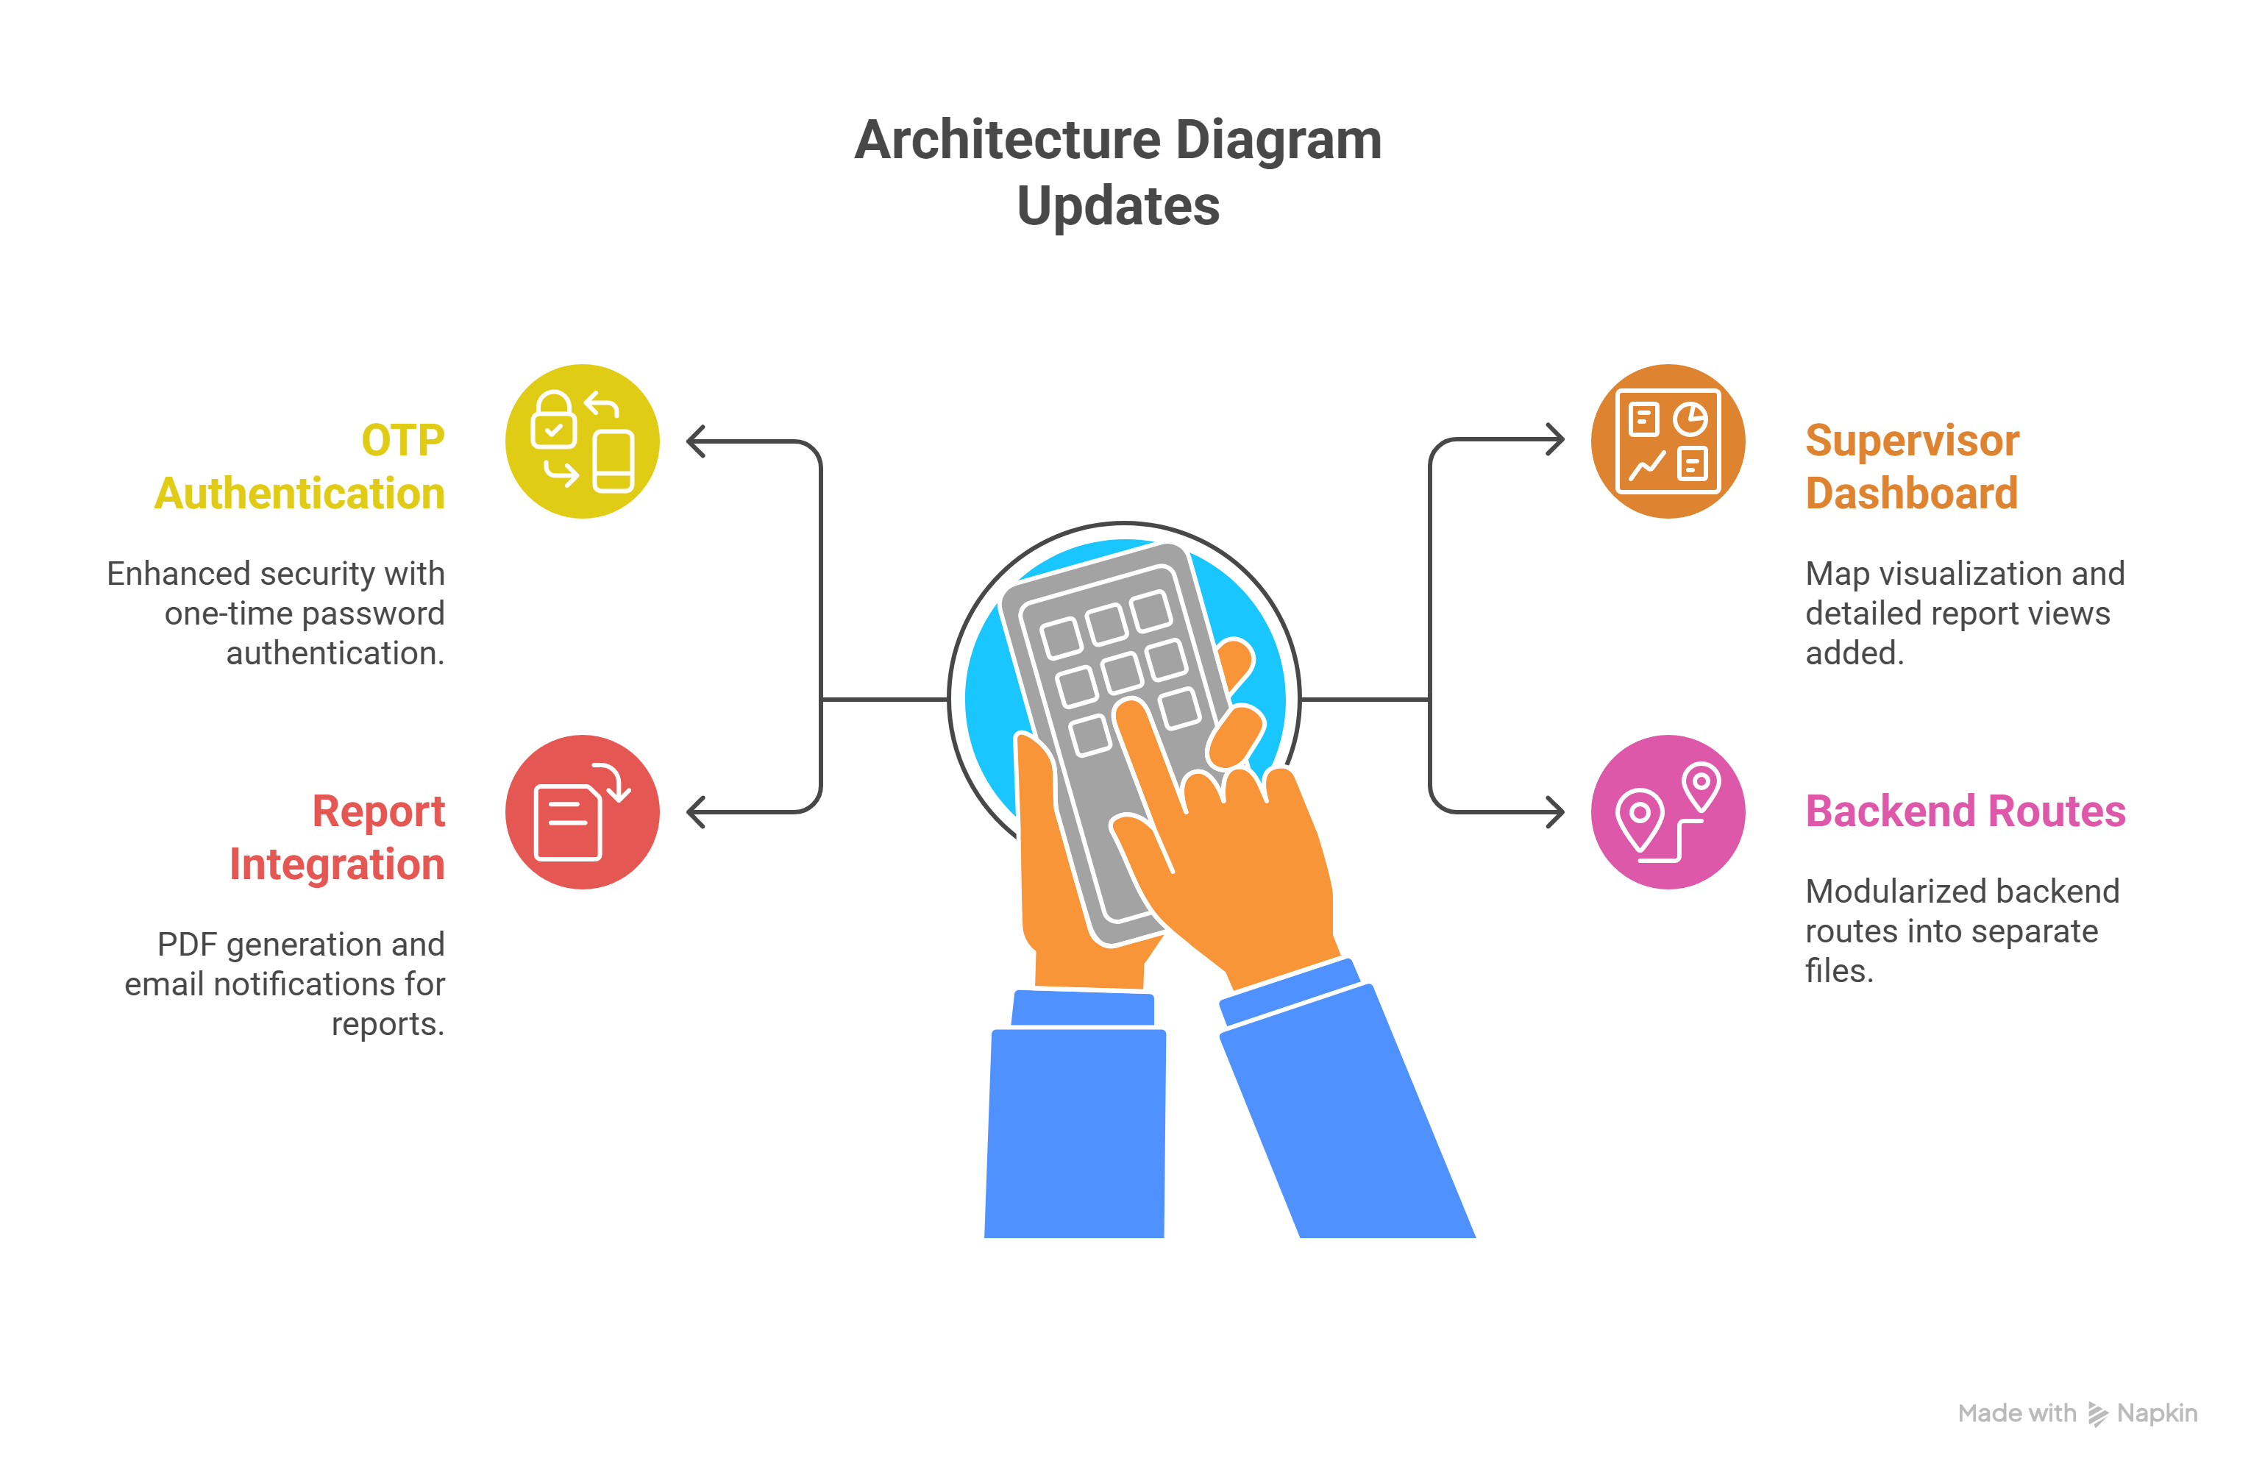
Architecture Updates and Key
Factors in ViT Model Selection
Notes:
This slide highlights the key architecture updates and factors influencing the selection of the Vision Transformer (ViT) model for the Safe Street project. We achieved milestone goals by implementing all planned features and core components as originally envisioned. The ViT model was selected due to its ability to capture global context in images, availability of pretrained models reducing training time, architectural advantages of transformers enhancing performance, and seamless compatibility with PyTorch for deployment. Key architecture updates include enhanced OTP-based authentication for security, integration of PDF generation and email notifications for reports, modular backend routes for maintainability, and a supervisor dashboard featuring map visualizations and detailed report views. These updates collectively strengthen the system’s robustness and usability.

Slide 8
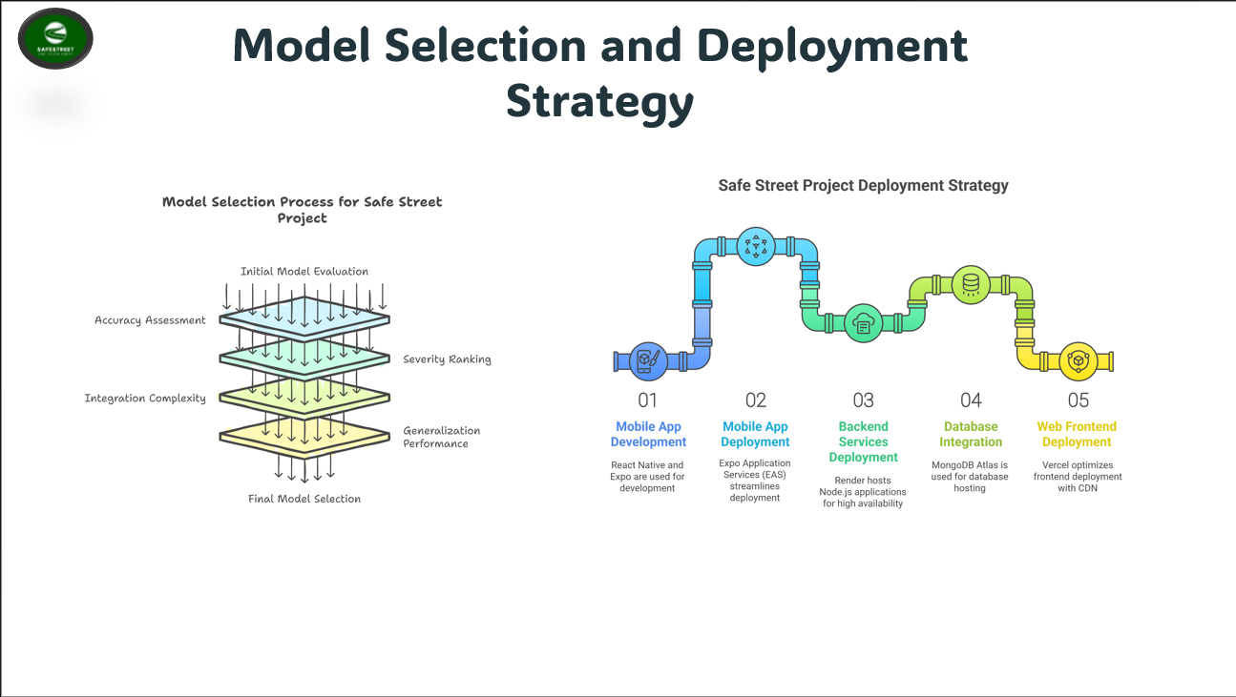
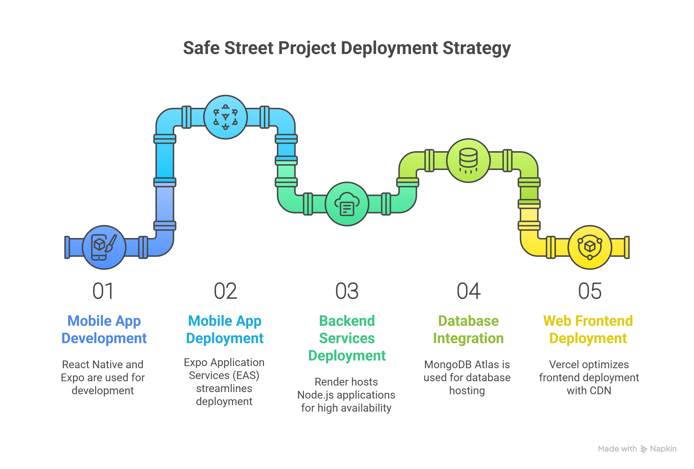
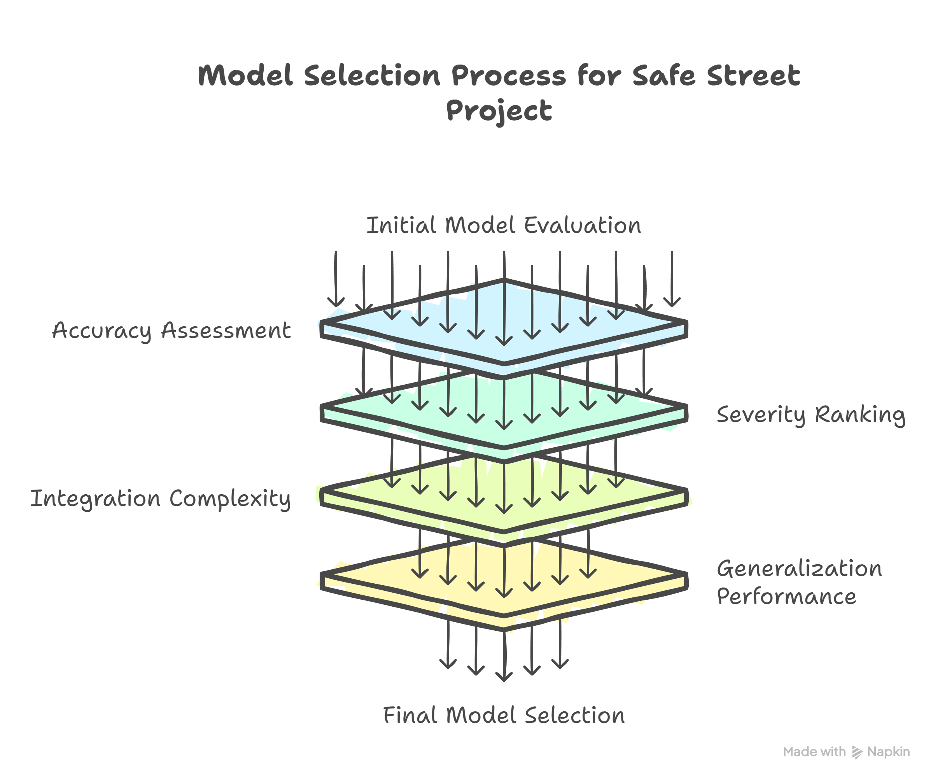
Model Selection and
Deployment Strategy
Notes:
This slide highlights our rigorous model selection process, where we evaluated models based on accuracy, severity ranking, integration complexity, and generalization performance to ensure the best fit for road damage detection. On the deployment front, we leveraged React Native and Expo for mobile app development and streamlined deployment with Expo Application Services. Our backend services are hosted on Render for high availability, MongoDB Atlas manages our database, and the web frontend is deployed on Vercel, optimizing delivery with a global CDN. This comprehensive strategy ensures a scalable, efficient, and robust system.

Slide 9


